Slide 1
training

Slide 2
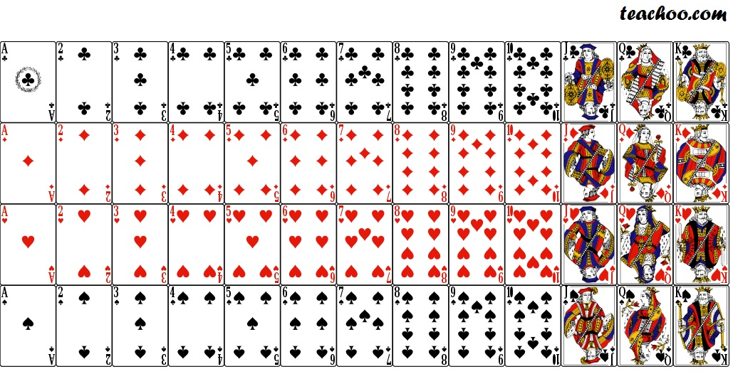

Slide 3
club
diamond
spade
heart

Slide 4
diamonds
clubs
hearts
spades
king
queen
jack
ace

Slide 6
ace
king
queen
jack

Slide 7
number cards
face cards

Slide 8

A
B
C
D
E
F
train1.png

Slide 9
A
B
C
D
E
F
train2.png

Slide 10
A
B
C
D
E
F
train_think1.png

Slide 11
A
B
C
D
E
F
train_think2.png

Slide 12
Who has a red card to play? Who can play a red card?

Slide 13
A
B
C
D
E
F
red1.png

Slide 14
A
B
C
D
E
F
red2.png

Slide 15
Who has a black card? Who can play a black card?

Slide 16
A
B
C
D
E
F
black1.png

Slide 17
A
B
C
D
E
F
black2.png

Slide 18
Who has a spade? Who can play a spade?

Slide 19
A
B
C
D
E
F
spade1.png

Slide 20
A
B
C
D
E
F
spade2.png

Slide 21
Who has a club? Who can play a club?

Slide 22
A
B
C
D
E
F
club1.png

Slide 23
A
B
C
D
E
F
club2.png

Slide 24
Who has a diamond? Who can play a diamond?

Slide 25
A
B
C
D
E
F
diamond1.png

Slide 26
A
B
C
D
E
F
diamond2.png

Slide 27
Who has a heart? Who can play a heart?

Slide 28
A
B
C
D
E
F
hearts1.png

Slide 29
A
B
C
D
E
F
hearts2.png

Slide 30
Who has a jack? Who can play a jack?

Slide 31
A
B
C
D
E
F
jack1.png

Slide 32
A
B
C
D
E
F
jack2.png

Slide 33
Who has a queen? Who can play a queen?

Slide 34
A
B
C
D
E
F
queen1.png

Slide 35
A
B
C
D
E
F
queen2.png

Slide 36
Who has a king? Who can play a king?

Slide 37
A
B
C
D
E
F
king1.png

Slide 38
A
B
C
D
E
F
king2.png

Slide 39
Who has a face card? Who can play a face card?

Slide 40
A
B
C
D
E
F
face1.png

Slide 41
A
B
C
D
E
F
face2.png

Slide 42
Who has a number card? Who can play a number card?

Slide 43
A
B
C
D
E
F
number1.png

Slide 44
A
B
C
D
E
F
number2.png

Slide 45
Who has an ace? Who can play an ace?

Slide 46
A
B
C
D
E
F
ace1.png

Slide 47
A
B
C
D
E
F
ace2.png

Slide 48
Who has a ten? Who can play a ten?

Slide 49
A
B
C
D
E
F
ten1.png

Slide 50
A
B
C
D
E
F
ten2.png

Slide 51
Who has an eight? Who can play an eight?

Slide 52
A
B
C
D
E
F
eight1.png

Slide 53
A
B
C
D
E
F
eight2.png

Slide 54
Who has a six? Who can play a six?

Slide 55
A
B
C
D
E
F
six1.png

Slide 56
A
B
C
D
E
F
six2.png

Slide 57
Who has a four? Who can play a four?

Slide 58
A
B
C
D
E
F
four1.png

Slide 59
A
B
C
D
E
F
four2.png

Slide 65

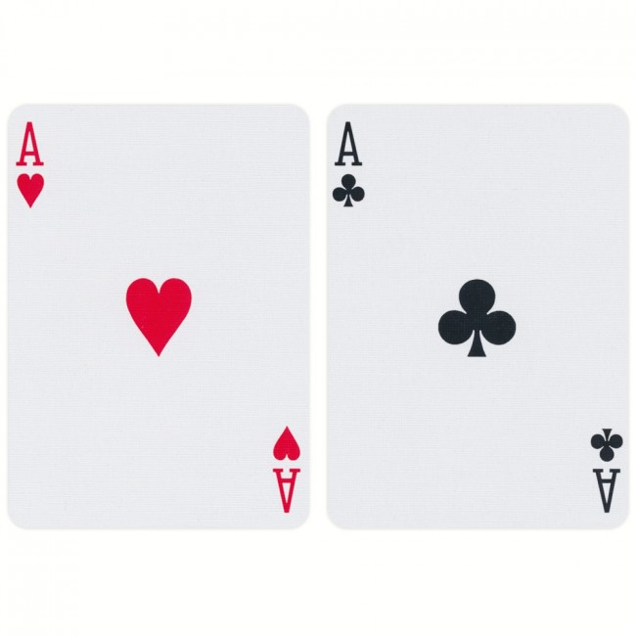
A
B
C
D
E
F

Slide 66
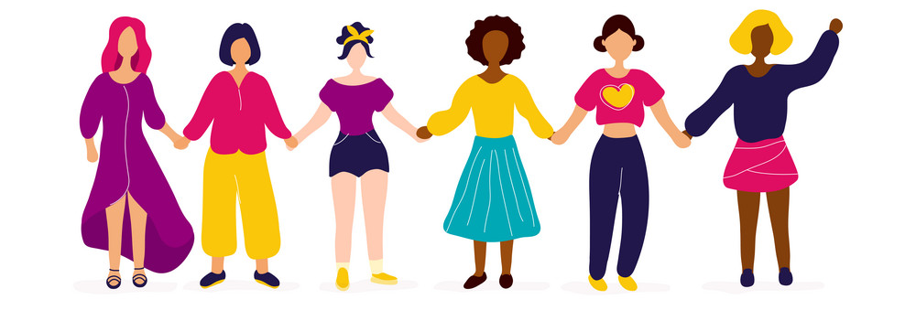
A
B
C
D
E
F
A
B
C
D
E
F

Slide 67
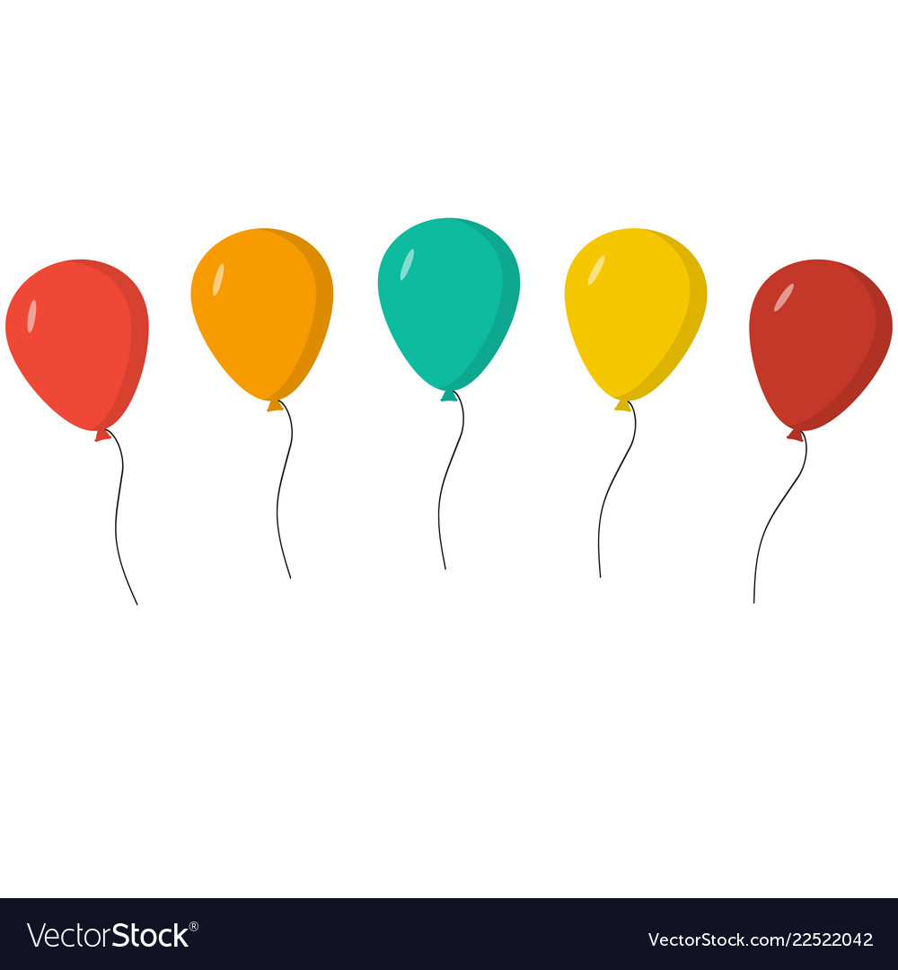
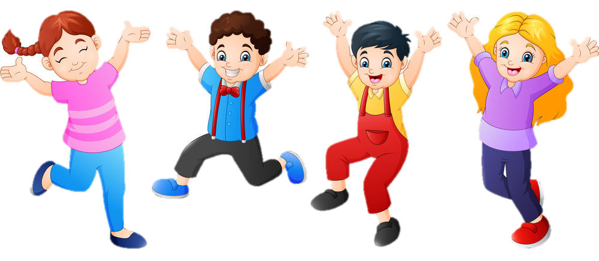
A
B
C
D

Slide 68
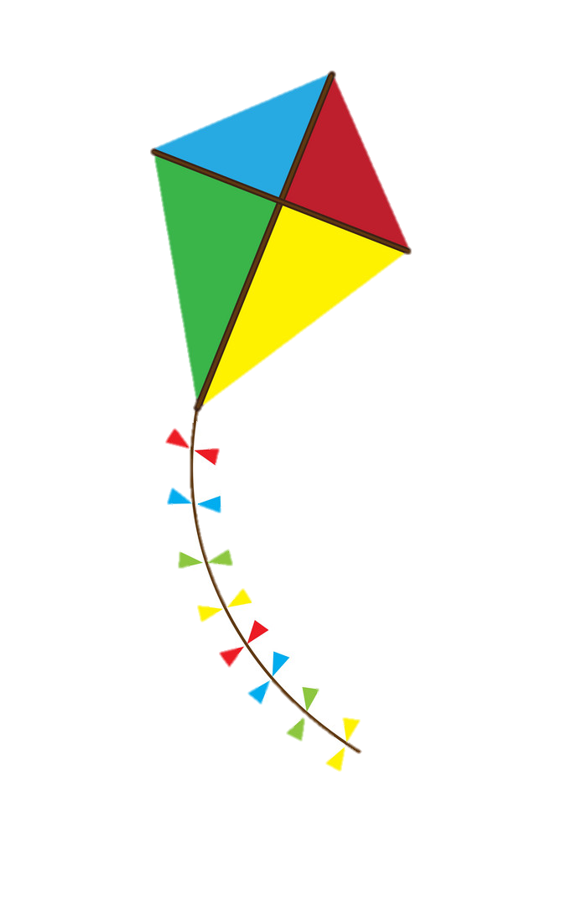
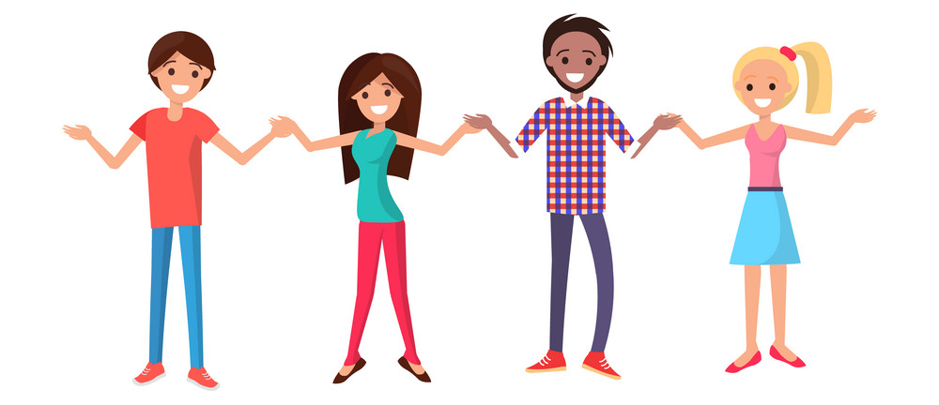
A
B
C
D

Slide 69




A
B
C
D
E
F

Slide 70
A
B
C
D
E
F

Slide 71
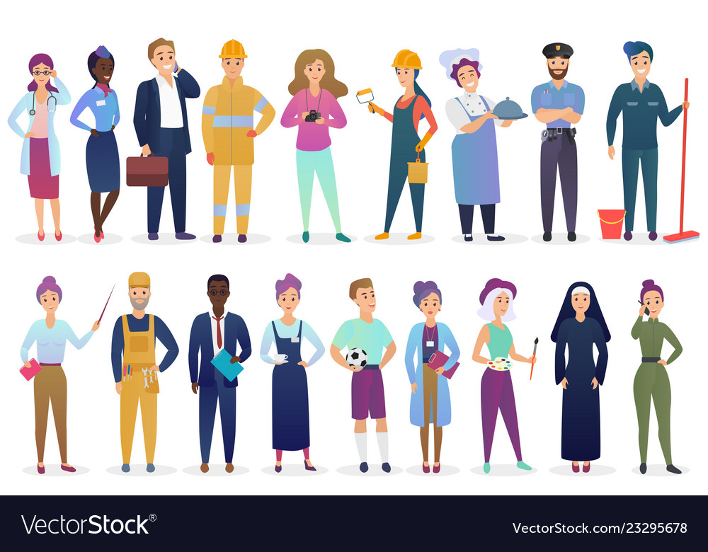

Slide 72
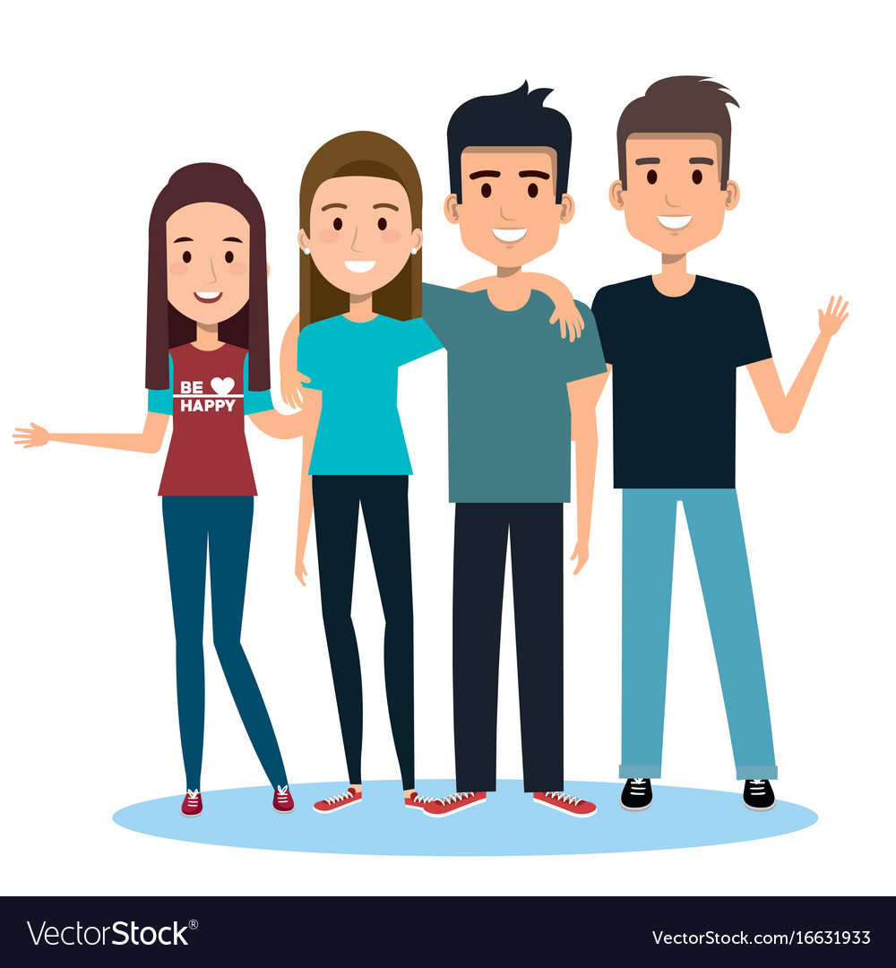

Slide 73
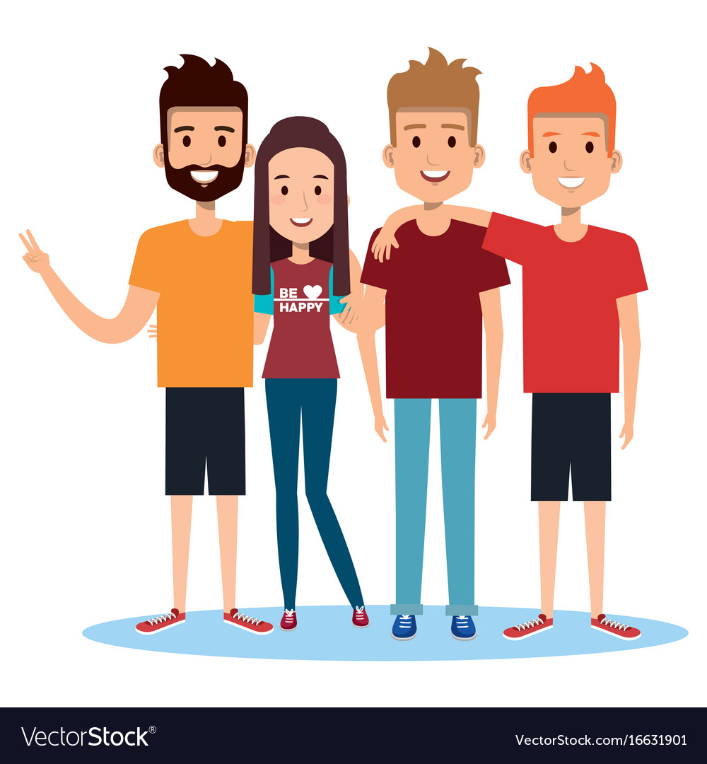

Slide 74
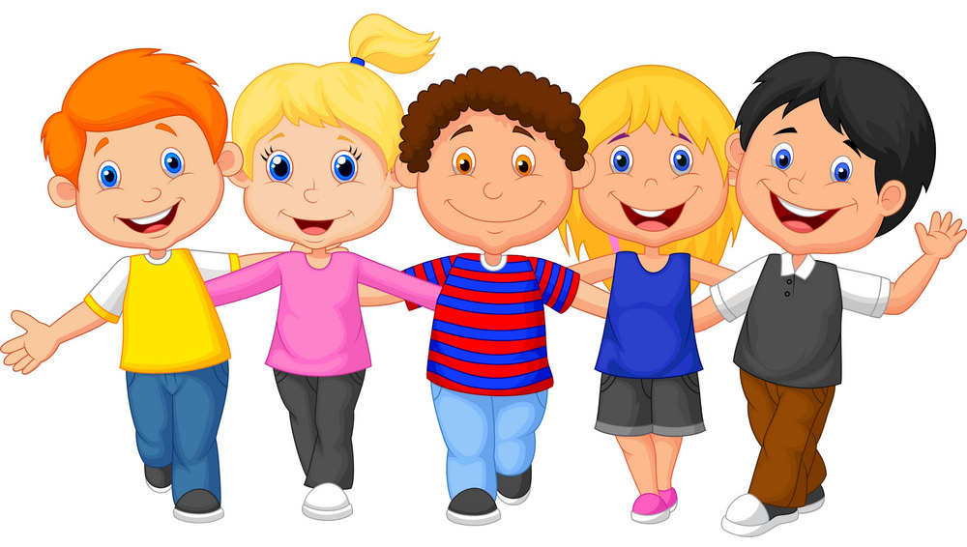
A
B
C
D
E
F

Slide 75


Slide 76


Slide 78
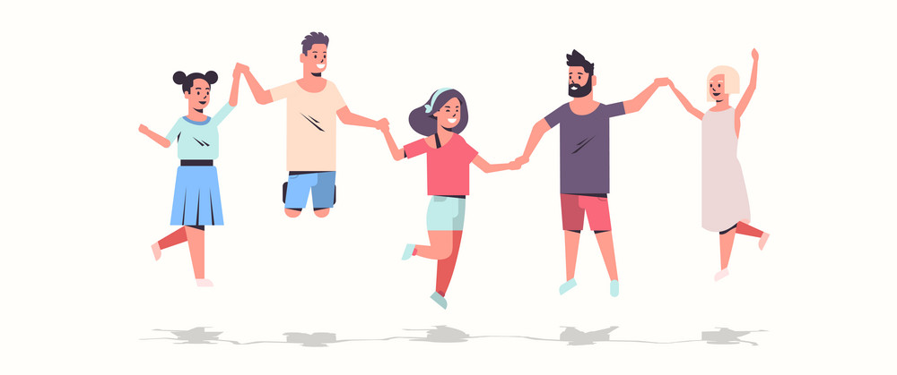

Slide 79
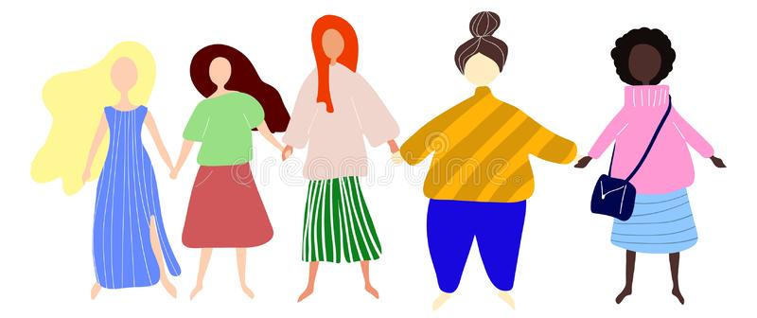
A
B
C
D
E

Slide 80










A
B
C
D
E
F

Slide 81
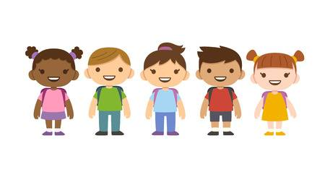
…10!
“1, 2, 3, 4, 5, 6, 7, 8, 9, 10!”
“1, 2, 3, 4, 5, 6, 7, 8, 9, 10!”
A
B
C
D
E
“1, 2, 3, 4, 5!”
“1, 2, 3, 4, 5!”

Slide 82


Slide 83
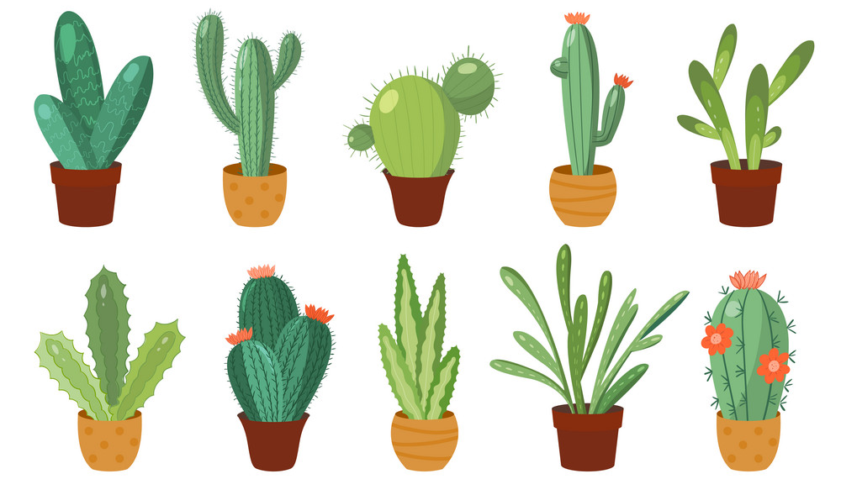

Slide 84
